Slide 1

Foreign Trade Balance
Fair and Future

Slide 2
Foreign Trade Balance
When evaluating whether states behave sufficiently economically and financially social enough towards the outside world, there are three main metrics:

Slide 3
Foreign Trade Balance
Voluntary contributions, limited in time and frequency, to other states or groups in times of need.
01
Commitment to establish a solid framework of mutual financial and economic support and compensation payments, up to and including a common framework with an institutional distribution, prioritization and regulation order.
02
Take care for balanced foreign trade and not live on export surplus at the costs of others.
03

Slide 4
Why a foreign trade balance policy is important:
Internationally, there is currently a production place competition between states's societies. You can also simply say between states. (i.e. Kampf der Nationen P.Kaczmarczyk –only in german– )
And states have, historically grown or by nature, different advantageous or disadvantageous locations for production with which they have to compete internationally with/against each other.
China and Germany in particular have a geo-location and climate zone advantage, but so does parts of the USA.
Within the EU but especially Germany.

Slide 5
In the words of others from the past:
If you know that Max Weber already reported in "The Protestant Ethic and the Spirit of Capitalism ([Chapter. I. 1. Site 2])" that some regions have a natural location advantage in the free common market due to their “traffic situation”. And if you know that Keynes also spoke of the fact that Germany could be a good neighbor for the rest of Europe if one use their economic power for common advantage [The Collected Writings of John Maynard Keynes XXV - Draft Statement from a proposals to counter the german 'New Order’ 1.12.1940 ], it was actually easy to foresee that Germany would extreme benefit from the common currency, its now even more economically favorable situation between the poor in the East and the rich in the West and the obligation for all EU-States to grant the 4 economic freedoms.

Slide 6
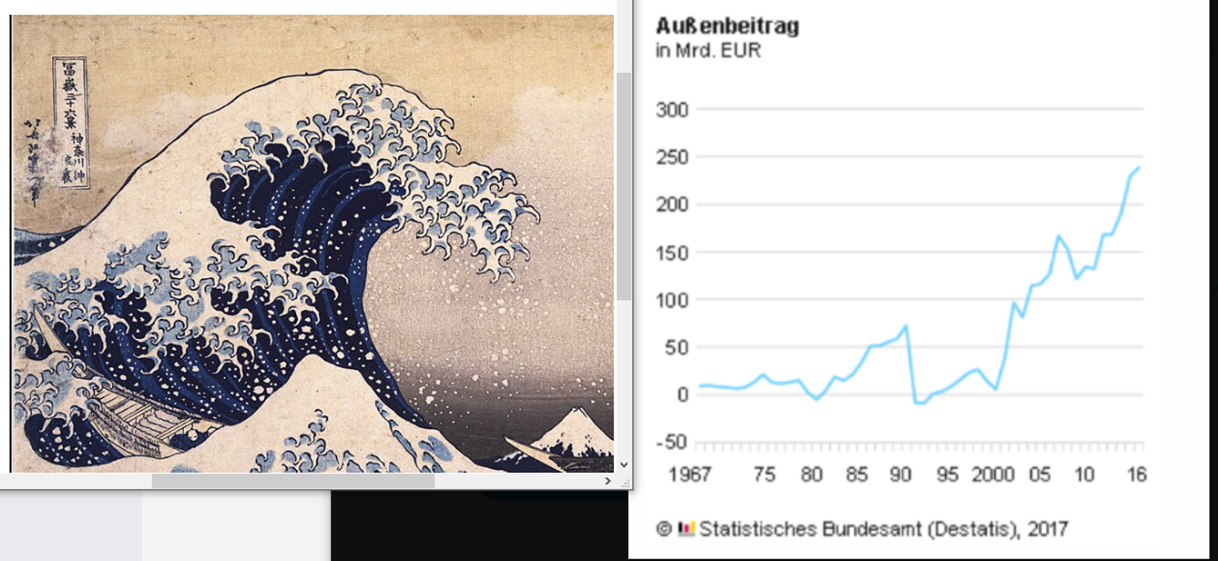
The Result:

Slide 7
The Result:
And that the result would be a strong migration movement driven by economic pressure and centering of the European economy towards Germany. And that therefore Germany would have enormous export surpluses and a foreign trade imbalance, if not Germany, now voluntarily because there was and still is no more easy opportunity for pressure as before from outside, would have done something toward a balanced foreign trade.

Slide 8
Regulation Theory
Was this what the regulation theory describes as a pact between capitalists and states with the by nature best locations, like Germany, in order to profit together at the expense of others and to accumulate shares as much as possible? Also it is well known that the rise of China took place during this time. China had probably also become necessary for stabilization according to the regulation theory. However, Germany's natural advantage could be noticeably diminished due to the Ukraine-Russia war and the partial loss of trade with the East.

Slide 9
„Stabilitätsgesetz“
And Germany even has a law which urge them to take care for a balanced foreign trade. But this stabilization law is simply ignored, or pretended to be replaced by the new EU-Contract Law. Many measures from the old law to reduce a surpluse are indeed not allowed anymore. I hope the surpluse fans in germany at least know that it is not always so easy to recreate stability after it has been wiped away after a certain point.

Slide 10
Thanks for your Attention
Thomas Hinkelmann
rkslp.org

